Slide 1
CSE 308 Software Engineering and Information System Design Sessional
Automation of
BCB’s
Game Development Committee
Group No: 01
Group Members:
1005091
1005111
1005113
1005115
1005120

Slide 2
National Manager
Operations Manager Game development
Programs Manager
Divisional Cricket Manager
Schools Cricket Project Officer
Facilities and Equipment Project Officer
Youth Cricket Competitions Officer
Facilities and equipment Administrator
Youth Cricket Administrator
Administrator Schools Cricket Competitions
Academy Head Coach
Manager-Coaches
Game Development Game education Manager
District Development Coach
Divisional Cricket Coach(8)
Game Education manager
Game Education deputy Manager
Game Education Administrator
Academy Operations Manager

Slide 3
Subsystems
Program Management System
Divisional Cricket Management System
Game Education Management System
Academy Operations Management System
Coach Management System
Control Management System

Slide 4
Program management
System

Slide 5
Actors
School Representative.
School Cricket Administrator.
Youth Cricket Administrator.
Facility and Equipment Administrator.
Program Manager.

Slide 6
Use case Glossary:
Use-case ID>> name | Actors
1.1Registration. | School representative, School Cricket Administrator
1.2 Arrange School Cricket Tournament | School Cricket Administrator, Program manager
1.3 Arrange Youth Cricket Tournament. | Youth Cricket Administrator, Program manager
1.4 Update tournament info | Youth Cricket Administrator
1.5 Ask for Facility and equipment. | School Cricket Administrator, Youth Cricket Administrator
1.6 Provide Facilities | Facility and Equipment Administrator

Slide 7
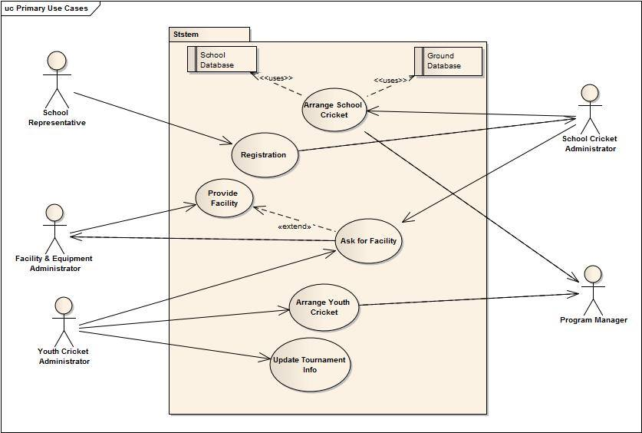
Use case Diagram:

Slide 8
1.1 Registration
Use-case name | Define route & price
Use-Case ID | 1.1
Priority | High
Primary Actor | School Representative
Secondary Actor | School Cricket Administrator
Description | School will register for upcoming tournament
Trigger | School Representative

Slide 9
Typical Course of Events
Actor Action | System Response
Fill up the form and submit it online. | The system will forward it to school cricket administrator.
The school cricket administrator will receive and check the form and accept it if it is okay. | The system will enroll the school and save the info into the school database
 | System will send an automatic confirmation email to the school.

Slide 10
Documentation of
Use Case (1.1) Course of Events
Conclusion: When the school entry is completed.
Post-Condition: Inform the school representative about the acceptance.
Implementation: GUI will be provided in the webpage for the registration to fill up the form.

Slide 11
1.2 Arrange School Cricket Tournaments
Use-case name | Define route & price
Use-Case ID | 1.2
Priority | High
Primary Actor | School Cricket Administrator
Secondary Actor | Program manager
Precondition | School registration must be completed
Description | Arrange School cricket tournament
Trigger | School Cricket Administrator

Slide 12
Typical Course of Events
Actor Action | System Response
School Cricket Administrator will schedule the school tournament using the school database and ground database. | The system will save the info and send it to Program manager.
The program manager will approve the tournament proposal. | The system will notify the acceptance to School Cricket Administrator

Slide 13
Documentation of
Use Case (1.2) Course of Events
Conclusion: Concludes when the approval is made.
Post-Condition: Inform the School Cricket Administrator about the approval.
Implementation: : GUI will be provided in the software the schedule platform and school database and ground database.

Slide 14
1.3 Arrange Youth Cricket Tournaments
Use-case name | Define route & price
Use-Case ID | 1.3
Priority | High
Primary Actor | Youth Cricket Administrator
Secondary Actor | Program manager
Description | Arrange youth cricket tournament
Trigger | Youth Cricket Administrator

Slide 15
Typical Course of Events
Actor Action | System Response
Youth Cricket Administrator will schedule the Youth tournament using the district and divisional cricket teams database and ground database. | The system will save the info and send it to Program manager.
The program manager will approve the tournament proposal. | The system will notify the acceptance to Youth Cricket Administrator

Slide 16
Documentation of
Use Case (1.3) Course of Events
Conclusion: Concludes when the approval is made.
Post-Condition: Inform the Youth Cricket Administrator about the approval.
Implementation: : GUI will be provided in the software the schedule platform and District and divisional teams database and ground database.

Slide 17
1.4 Update Tournaments Info
Use-case name | Define route & price
Use-Case ID | 1.4
Priority | High
Primary Actor | Youth Cricket Administrator
Description | Store tournaments Information
Trigger | Youth Cricket Administrator

Slide 18
Typical Course of Events
Actor Action | System Response
Youth Cricket Administrator observes each match results and scorecard and store it into the database. | The system will save the info

Slide 19
Documentation of
Use Case (1.4) Course of Events
Conclusion: Concludes when the database is stored.
Post-Condition: Notify that the information is successfully stored.
Implementation: : Provide a window to enter data.

Slide 20
1.5 Asks for facilities and equipments
Use-case name | Define route & price
Use-Case ID | 1.5
Priority | High
Primary Actor | School Cricket Administrator, Youth Cricket Administrator
Secondary Actor | Facilities and Equipments Administrator
Precondition | School cricket tournament, Youth cricket tournament must be scheduled
Description | Request to provide necessary Facilities and Equipments
Trigger | School Cricket Administrator or Youth Cricket Administrator

Slide 21
Typical Course of Events
Actor Action | System Response
School Cricket Administrator or Youth Cricket Administrator will list the necessary equipments and facilities and send it to facilities and equipment manager. . | The system will send it to facilities and equipment manager.

Slide 22
Documentation of
Use Case (1.5) Course of Events
Conclusion: Concludes when the request is sent.
Post-Condition: Notify that the request is successfully sent.
Implementation: : Provide a window in the software to enlist the facilities and equipments.

Slide 23
1.6 Provide facilities and equipments
Use-case name | Define route & price
Use-Case ID | 1.6
Priority | High
Primary Actor | Facilities and Equipments Administrator
Secondary Actor | Program manager
Precondition | Request for facilities and equipments by School cricket administrator and youth cricket administrator
Description | provide necessary Facilities and Equipments
Trigger | Facilities and Equipments Administrator

Slide 24
Typical Course of Events
Actor Action | System Response
The Facilities and equipment manager will see the request and approve and keep the database about the provided facilities. | The system will save the info in the database.
If the necessary equipment is not enough then the Facilities and equipment manager will inform the program manager about the shortage. | The system will notify this to the program manager.

Slide 25
Documentation of
Use Case (1.6) Course of Events
Conclusion: Concludes when the data is stored.
Post-Condition: Notify that the Data are successfully stored.
Implementation: : Provide a window in the software to store the provided facilities and equipments.

Slide 26
Divisional
Cricket management
System

Slide 27
Use case Glossary:
Use-case ID>> name | Actors
2.1 Form District Teams | District Cricket Coach
2.2 Recommend Players | District Cricket Coach , Divisional Cricket Coach
2.3 Form divisional Teams | Divisional Cricket Coach
2.4 Assign Coaches | Divisional Cricket Manager

Slide 28
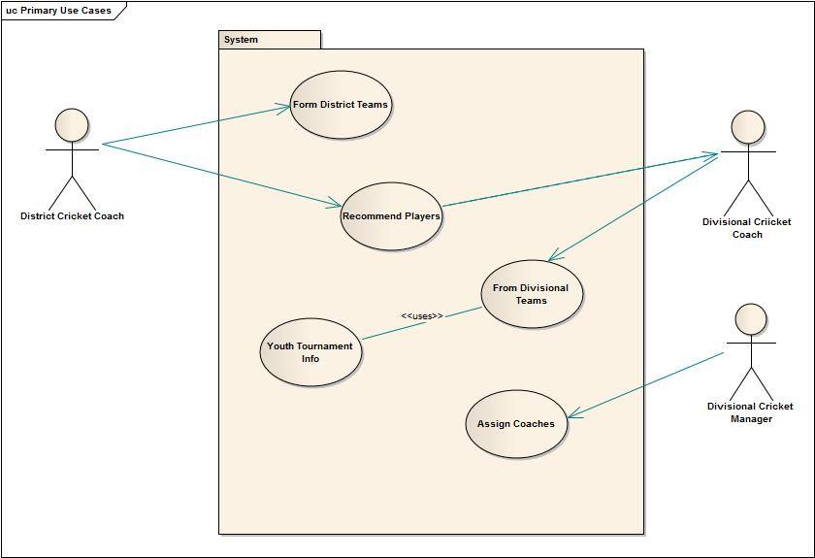
Use case Diagram:

Slide 29
Game Education
management
System

Slide 30
Use case Glossary:
Use-case ID>> name | Actors
3.1 Maintain Educational Database. | Game Education Deputy Manager
3.2 Assign Teacher. | Game Education Deputy Manager
3.3 Monitor Educational Performance. | Game Education Deputy Manager
3. 4 Assign Courses for Players. | Game Education Deputy Manager, Game Education Manager

Slide 31
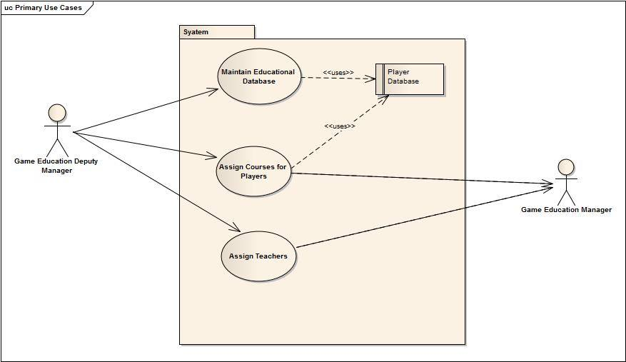
Use case Diagram:

Slide 32
Academy Operations
management
System

Slide 33
Use case Glossary:
Use-case ID>> name | Actors
1. Observe Players Lacking. | Academy Operation Manager, Operation manager
2. Assign Head-coaches. | Academy Operation Manager, Operation manager

Slide 34
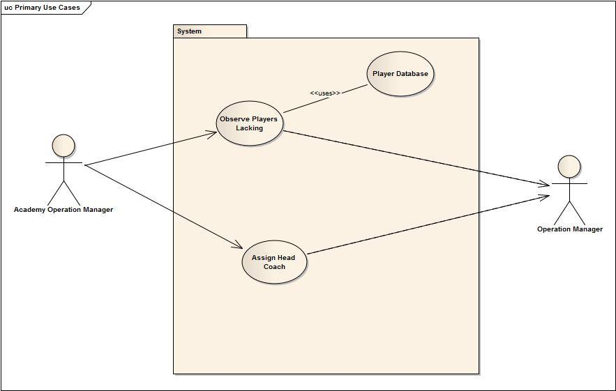
Use case Diagram:

Slide 35
Coach management
System

Slide 36
Use case Glossary:
Use-case ID>> name | Actors
1. Maintain all academy coaches. | Manager-Coach
2. Maintain all academy teams. | Manager-Coach
3. Notify | Manager-Coach, Operation Manager

Slide 37
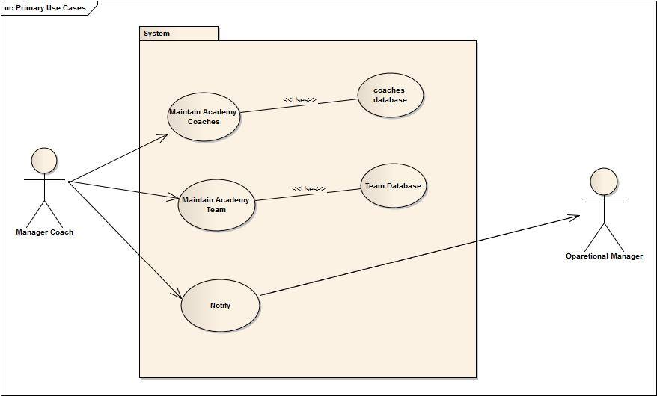
Use case Diagram:

Slide 38
Control
management
System

Slide 39
Use case Glossary:
Use-case ID>> name | Actors
6.1 Observe all Subsystem. | Operation Manager
6.2 Notify | Operation Manager, National Manager
6.3 Contact BCB | National Manager

Slide 40
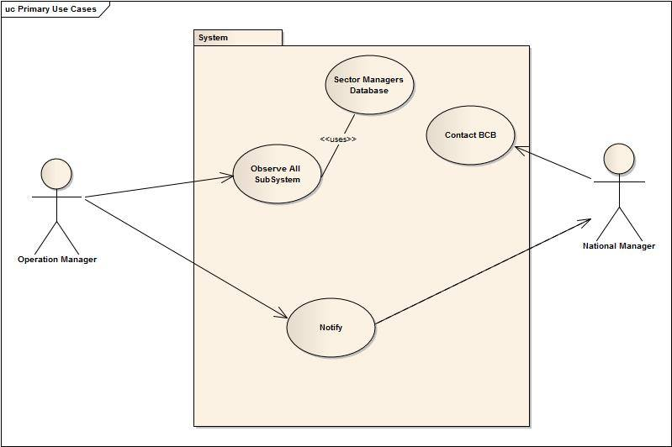
Use case Diagram:

Slide 41
Thank You

